Slide 1


Ricardo Martinez
Florida International University
Fall 2014

Slide 2
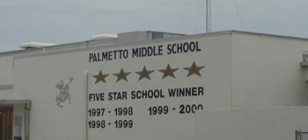
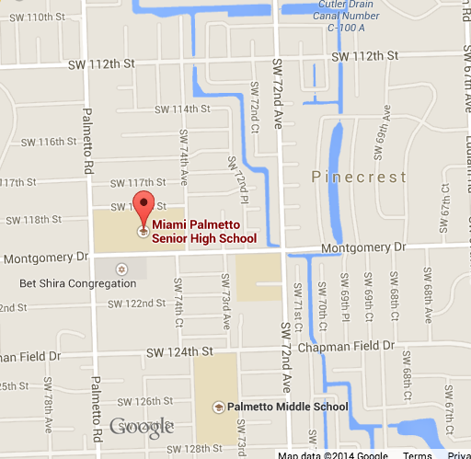
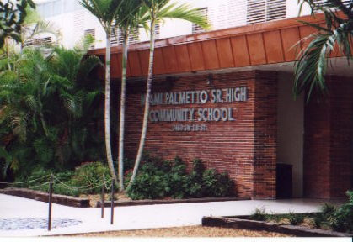
Where does the People Mover take you?
Palmetto Middle School
Address: 7351 SW 128th Street Miami, FL 33156
Miami Palmetto Senor High
Address: 7460 SW 118th Street Pinecrest, FL 33156

Slide 3
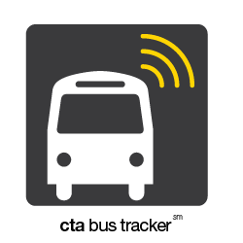
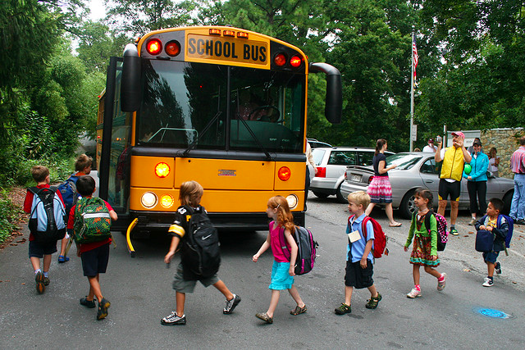

People Mover Issues:
No way of tracking bus
Has my child arrived safely?
Is the bus near me?
Where is the closest stop?
How far is the bus from a stop?

Slide 4
Have no fear the Pinecrest People Mover App is here!

Slide 5
Solutions
User can see the estimated time for particular stop
User can see the estimated time for their set favorite stop
User can find the nearest stop to their location per route
User can see all the stops and routes on the map view

